Slide 1

Wakefield Family Together
Leadership Programme
Information

Slide 2
What is the Wakefield Families Together Leadership Programme?
A Leadership Programme co-designed by the Staff College and Wakefield Safeguarding Children Partnership to support Managers and Leaders.
Gain confidence in Systems Leadership theories and practice whilst embedding the learning within your own agency.

Slide 3
To reflect on your leadership, explore some new ideas and to learn from one another.
Explore how as leaders you can influence services to create better
outcomes for families.
Explore the construct of systems leadership within the context
of a complex and often turbulent world of public service provision
The use of networking outside of you service to build upon
existing relationships.
Confident leaders, effective at understanding strategic and systems leadership and their role
Stronger, self-directing network of managers.
AIMS and OBJECTIVES

Slide 4
Building blocks for Leadership
Systems leadership
Leadership for effect
Applied skills
Adaptive and systems leadership
Collaborative capital
Building partnerships and alliances
Understanding self as leader – 360 survey
Cultural competence
Personal and collective agency
Presentation and communication skills
Leading and managing outside your comfort zone
Leading by coaching
Courageous conversations
Leading restorative practice
Critical analysis – using evidence and quality assurance
What works in improving outcomes
Leadership challenge
Action Learning Sets
Mentoring

Slide 5






WHY?
Individual agency: People get more power and control in their own lives: activation, shared decision-making and self- care
Collective agency:
People act together, united by a common cause, harnessing the power and influence of the group and building mutual trust

Slide 6

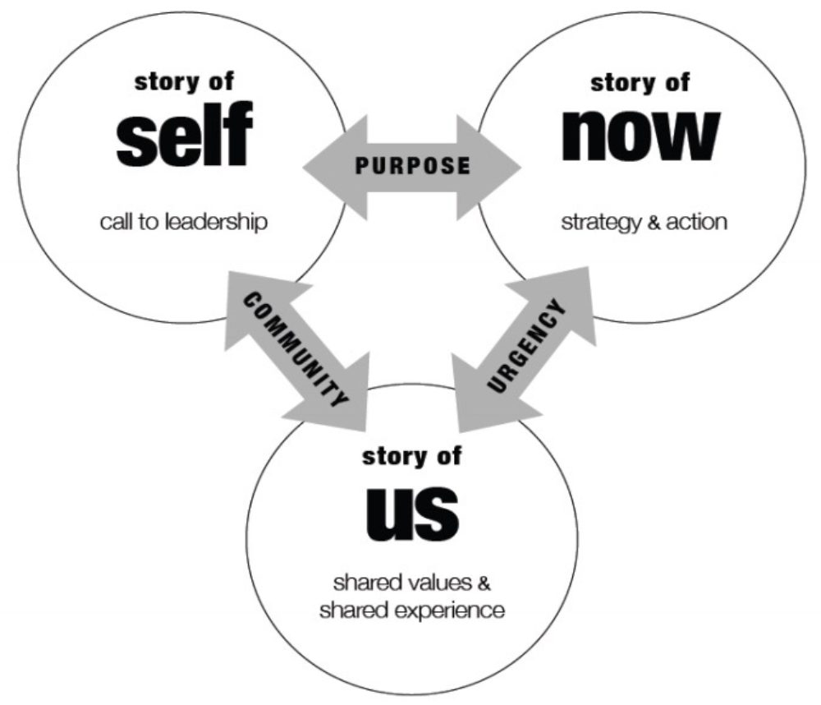
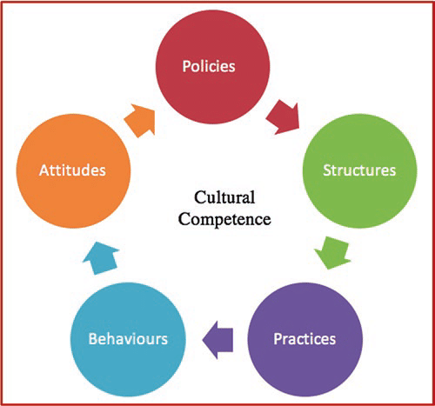
Leading practice to improve
Restorative practice
Evidence informed practice
What works
Leading change
Public narrative
Leading and managing high performing teams
Creating the context for increased equity in the workplace and improved service provision for diverse communities

Slide 7
Managers / Line Managers / Coordinators who are in a position to embed systems leadership within their own agency.
Practitioners who have a passion and commitment to learning, collaborative working and building relationships.
Workers who have a desire to under the wider lens to agency working.
Who to Attend?

Slide 8
Important Information
Nomination to be emailed to WSCP by 29th September 2023
360 to be completed by worker prior to starting programme
Dates of WFT Leadership Programme; 23rd and 24th January 2024, 20th February 2024, 19th March 2024, and 23rd April 2024.
Venue TBC.
Times 9.30am – 3pm

Slide 9
Discuss who you wish to nominate with the worker, and email their name to;
wscpevents@wakefield.gov.uk
What Next?

