Slide 1
Partnership intelligence portal (PIP)
West Yorkshire police

Slide 2
Partnership intelligence portal
It is a web based system giving partner’s direct access to submit intelligence to the heart of West Yorkshire Police Intelligence function
To submit the information that is routinely gathered by partners during the course of their normal duties

Slide 3
Its not designed to:
Replace any current referral/reporting mechanisms already in place
Crime reporting
Or report anything that needs an urgent Police response

Slide 4
Who can access the portal?
Any partner/organisation can be considered for access to the portal, such as:
Local government, 3rd sector, Health, Emergency Services, Education, Justice System, Environmental, Housing, Charities, Commercial Businesses, Utility Companies

Slide 5
Who can access the portal?
Each organisation can be given one account, or;
Multiple accounts for different depts/teams.
You decide who will be allowed to access & submit

Slide 6
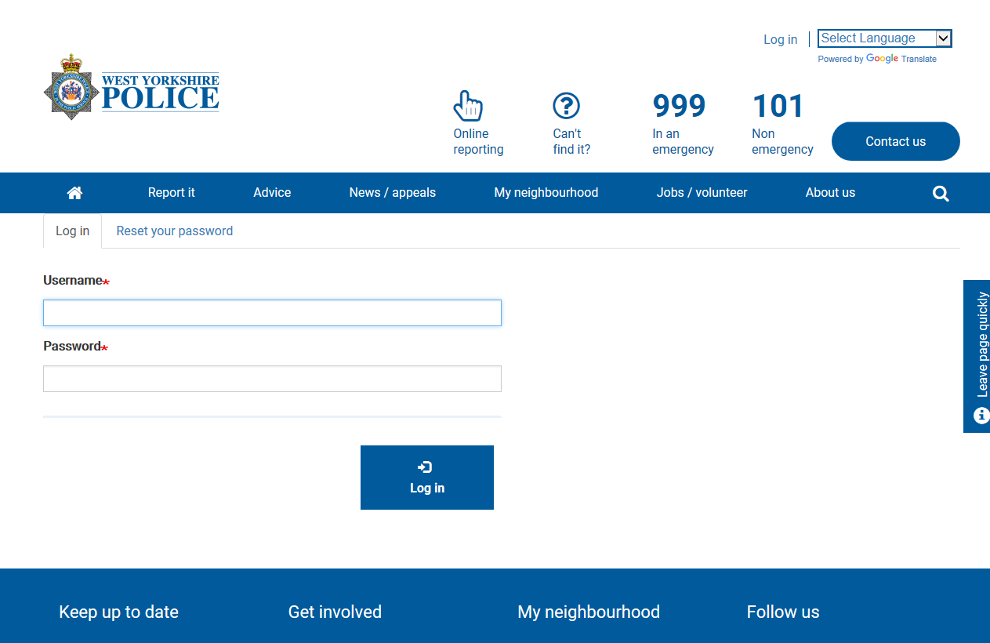
Portal demo
https://www.westyorkshire.police.uk/form/intel-submissions-form-check

Slide 7
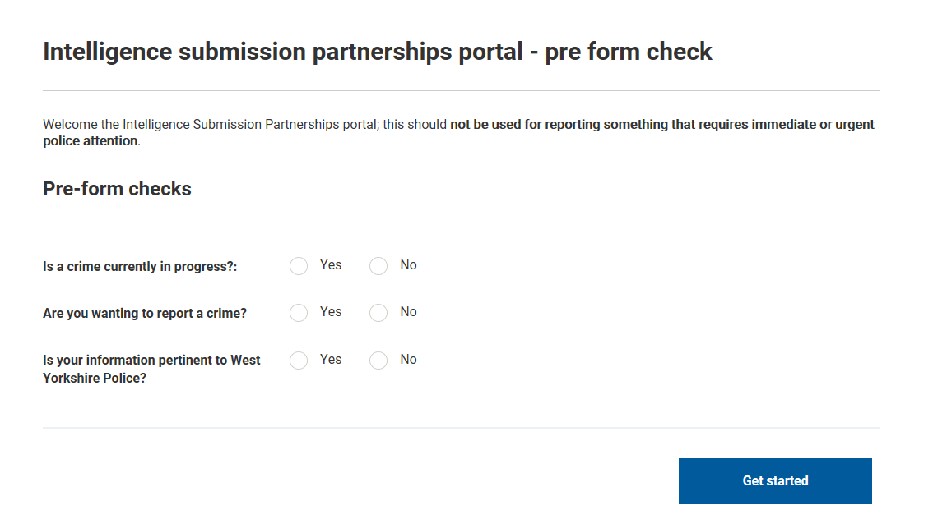

Slide 8
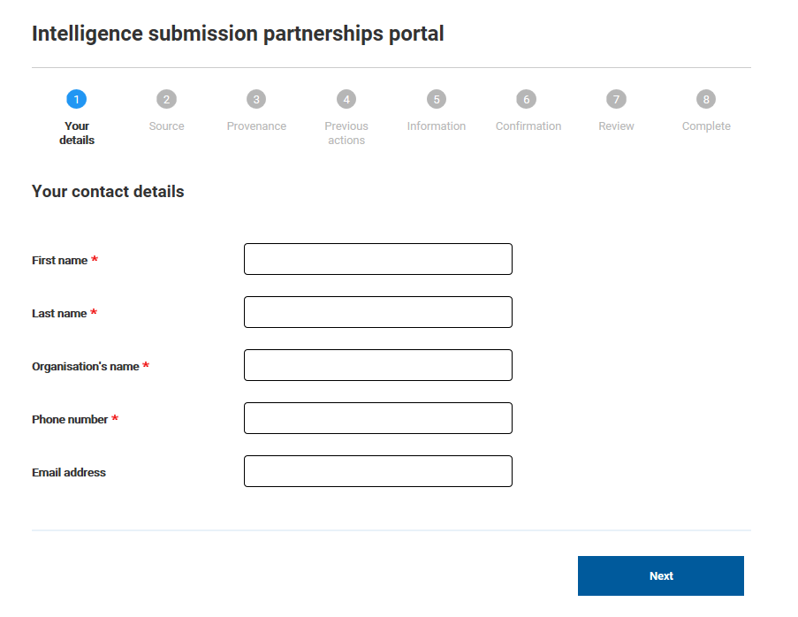

Slide 9
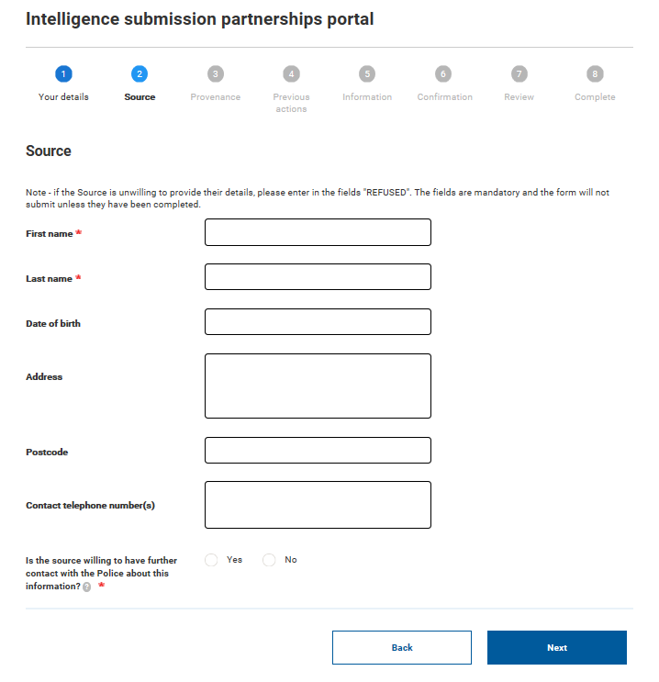

Slide 10
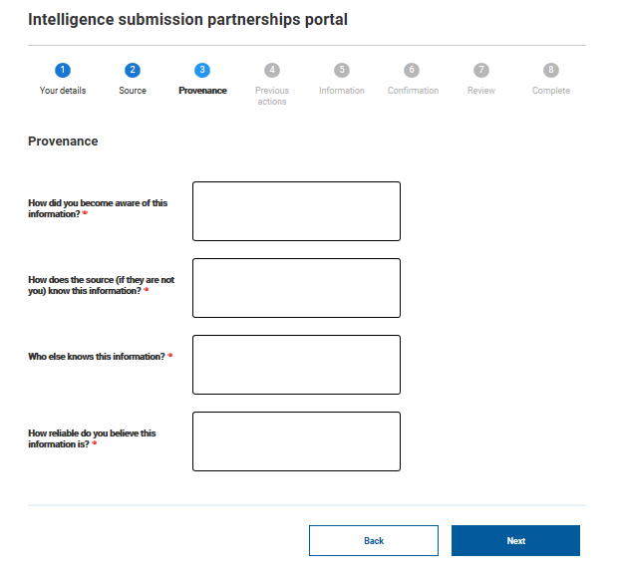

Slide 12
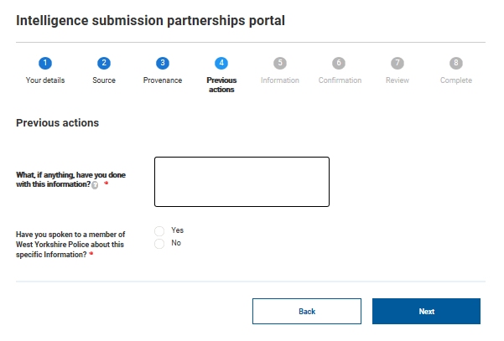

Slide 13
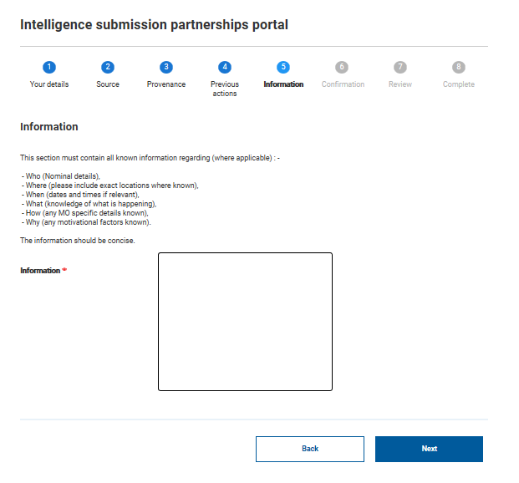

Slide 14
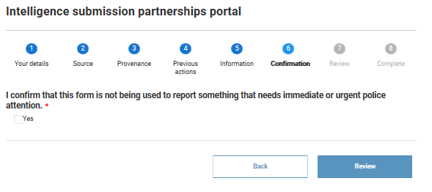

Slide 15
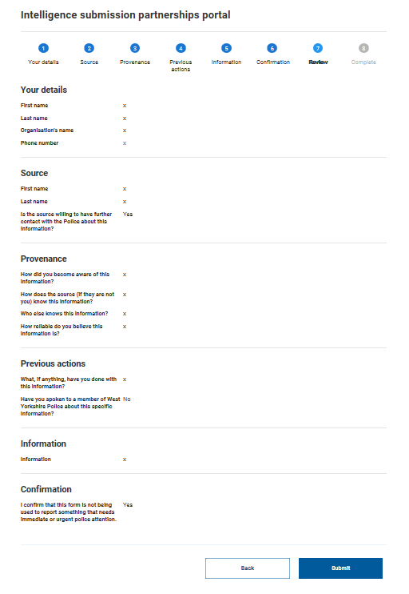

Slide 16
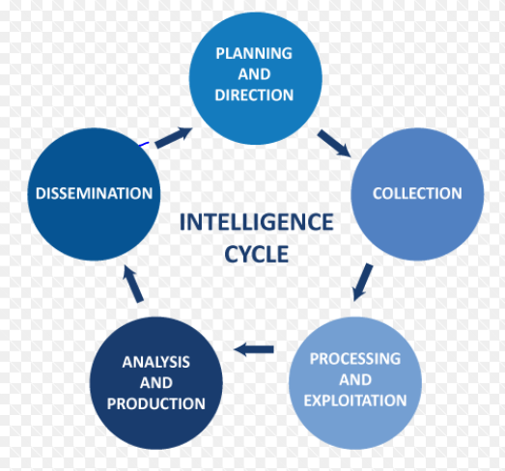
What do we do with your information
The Central Intelligence Unit assesses, evaluates and processes the information
Any “actionable” or “developmental” intelligence is tasked to the local District Intelligence Unit
Possible further tasking to other local District Police departments, e.g. Safeguarding or Neighbourhood Policing Teams

Slide 17
How to request access
Email:
XC.PIPaccess@westyorkshire.pnn.police.uk

Slide 18
Useful information
Video demonstration of the Partnership Intelligence Portal:
https://www.bishopgarth.com/ilearn/670PolicePartnershipIntelligencePortal/index.html

