Slide 1
CO screening in pregnancy
CO < 4ppm
Non-smoker
Normal result
CO at every AN appt.
Record in maternity notes
Smoker
Refer to smokefree pregnancy service
CO at every AN appt.
Discuss risks
Record in maternity notes
Non-smoker CO = or > 4ppm
No symptoms of CO poisoning
Discuss 2nd hand exposure
Encourage CO detector in the home
Signs and symptoms of CO poisoning
CO at every AN appt.
Record in maternity notes
Gas safety number
Has symptoms of CO poisoning
As above plus
Refer to A&E Pinderfields for assessment
Assess fetal wellbeing
If CO poisoning is suspected remember other members of the home
Smoker CO = or > 4ppm
No symptoms CO poisoning
Refer to smokefree pregnancy service
Discuss raised result
Signs and symptoms of CO poisoning
Encourage CO detector in the home
CO at every AN appt.
Record in maternity notes
Gas safety number
Has symptoms of CO poisoning
As above plus
Refer to A&E Pinderfields for assessment
Assess fetal wellbeing
If CO poisoning is suspected remember other members of the home
Signs of CO poisoning
Headache
Nausea and vomiting
Vertigo
Gas safety number
0800 111 999

Slide 2
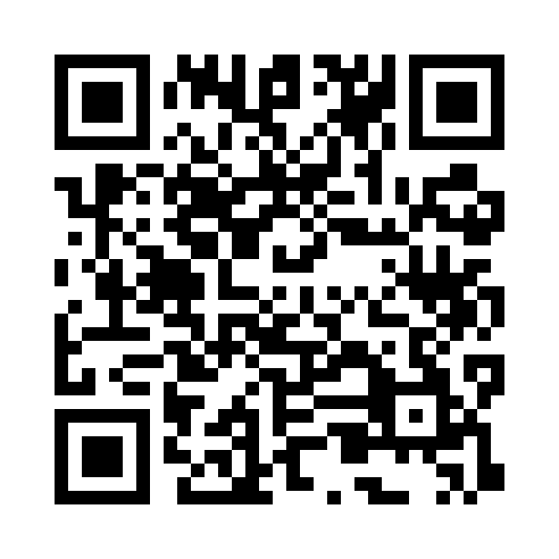
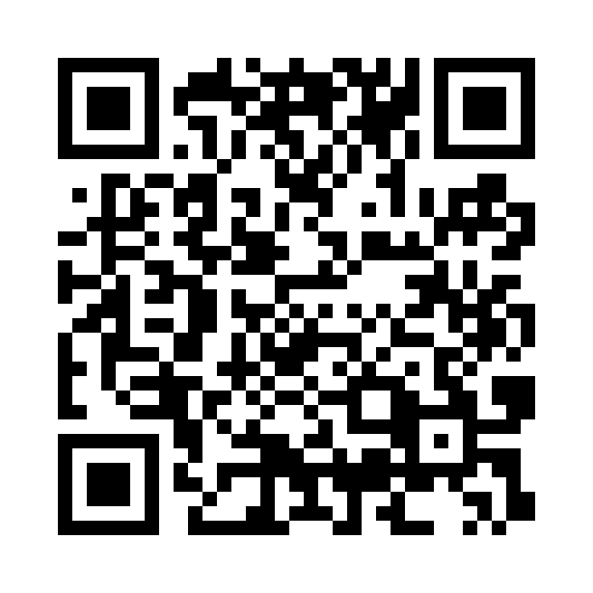
Stop smoking support for significant others
Dewsbury
Self-referral available via an online form at Kirklees Wellness Service:
kirkleeswellnessservice.co.uk/service/stop-smoking
Call: 01484 234095
Wakefield & Pontefract
If they consent to a referral, they can:
phone the Stop Smoking Service directly, or
you can call on their behalf with their name and number, allowing the service to contact them.
Free from a landline: 0800 612 0011
Free from most mobiles: 0660 1166
yorkshiresmokefree.nhs.uk

