Slide 1



A compassionate approach to supporting women with a raised BMI in pregnancy

Slide 2
Pregnancy and Obesity
Pregnant women and birthing people living with maternal obesity are at greater risk of a variety of pregnancy-related complications, including pre-eclampsia, deep vein thrombosis and gestational diabetes
Obesity requires similar ongoing management as many other long term conditions and is accompanied by a degree of stigma that can make choice and birth planning more difficult
This toolkit aims to encourage a compassionate approach to supporting women with a raised BMI and has been developed by Midwives from across MYTT, CHFT, the ICB and partners working in organisations providing support for people living with Obesity across West Yorkshire

Slide 3
The importance of language
Every day we choose words that have a profound effect on other people. Words have great potential to help or to harm and as clinicians, we know the strong value of good communication in our day-to-day practice
Whilst the science and physiology is complex and we are always discovering new things about obesity, what we do know for sure is the stigma people living with obesity experience every day
Clinicians interacting with service users have a clear opportunity to ensure that their conversations do not inadvertently contribute to this existing stigma.
You can choose language that is inclusive and supportive

Slide 4
What women told us…
Survey posted online for women & birthing people accessing care at MYTT or CHFT
67 responses
48% did not find information given around obesity useful
56% understood associated risks and 48% found discussions around the risk to be a negative experience
57% find language used around raised BMI negative
They did not find it helpful to be ‘told’ they could not pursue a particular care pathway and would prefer to be given information and options

Slide 5
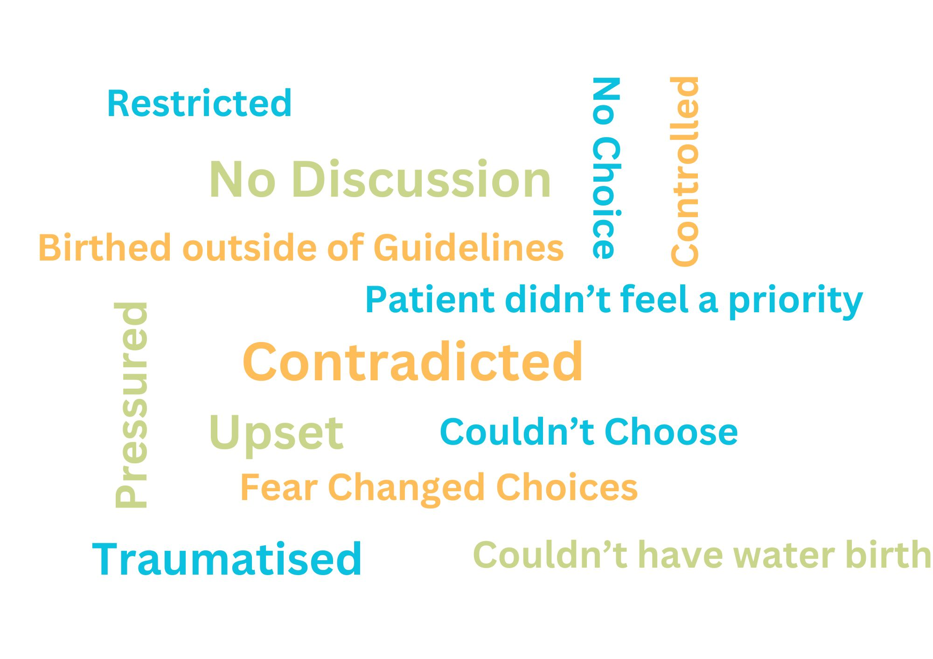
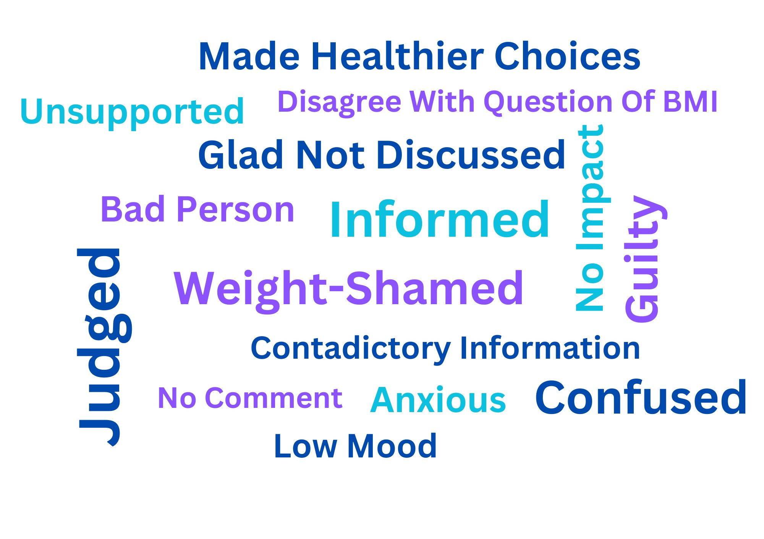
What women told us…
Telling women they “can’t” have their birth or can’t have certain monitoring in labour. Say ‘we don’t recommend’
I think it should be important to understand that having a raised BMI isn’t just because of poor choices and ignorance. It also can be past trauma.
Having more support for woman with a higher BMI and giving them a chance to ask more questions and an in detail meeting about it and how it effects mine and baby’s health
ASK women if they want help with their weight, don't force 'help' on them if they don't want it.
I was told very clearly that I couldn't have a water birth.
Don't make fat people feel like they're bad for choosing to have a family.
All the advice was to eat healthy and exercise more, both of which I was doing the best I could
The pressure to do what the Consultant said ‘was best’ was overwhelming
Don’t assume I am unhealthy because I have a raised BMI
Treat the person in front of you, not the risk factors and maybes.

Slide 6
What midwives & Doctors told us…
Survey emailed for staff working in antenatal areas at MYTT and CHFT
23 responses
Most feel comfortable discussing raised BMI
Unsure what resource is available
Open to a compassionate approach to care for raised BMI
Majority would welcome further guidance and support

Slide 7
A compassionate approach-
7 principles
A compassionate approach will support women to feel empowered and valued as an individual just the way they are:
Positive language
Free from judgement or negative connotations that may make women feel ‘told off’ or threatened about the consequences of their weight on their pregnancy or baby. Build self-esteem and encourage self-worth
Fully acknowledge the impact of external factors or wider determinants that influence and impact on health and wellbeing. See the woman as an individual with her own thoughts and feelings about her wellbeing and pregnancy. It is likely that not everyone will see their weight as a problem
Don’t generalise
Stick to evidence
Empathetically communicate accurate, evidence-based information that has balance and is supported by data
Don’t assume that having a raised BMI is due to having an unhealthy diet or lifestyle (lots of people have these and are not overweight)

Slide 8
Be empathetic
Avoid making assumptions about how women feel about their weight, understand that there are many different approaches to understanding someone’s health
Avoid humour
Never use humour or ridicule when discussing weight or attitudes and approaches to health and wellbeing, it does not ‘soften’ or make the discussion more light-hearted
Have open and honest conversations. Listen to how the woman describes her weight and body and emulate this. Use her own language as a basis to explore her thoughts and feelings and what support she might want. Do not tell women they ‘cannot’ have certain care (such as a pool birth), instead explore and provide factual information
Listen and explore
Don’t blame
Avoid language that puts the responsibility of a woman’s weight on her – there are many reasons why someone’s BMI is raised. For someone to feel supported, it’s important they don’t feel blamed

Slide 9
Resources
The relationship built by maternity care providers and service users is crucial in ensuring people feel heard and able to voice their thoughts and feelings
Useful websites:
https://www.rcog.org.uk/for-the-public/browse-our-patient-information/being-overweight-in-pregnancy-and-after-birth/
https://pmc.ncbi.nlm.nih.gov/articles/PMC10911863/
https://www.rcog.org.uk/guidance/browse-all-guidance/green-top-guidelines/care-of-women-with-obesity-in-pregnancy-green-top-guideline-no-72/
https://allaboutobesity.org/
https://www.nhs.uk/better-health/
https://www.doncaster.gov.uk/services/health-wellbeing/doncaster-s-compassionate-approach-to-weight

